Slide 2

Hiscox Baptist Manual
Chapter III, NOTE 8.– “Baptism is not essential to salvation, for our churches utterly repudiate the dogma of "baptismal regeneration"; but it is essential to obedience, since Christ has commanded it. It is also essential to a public confession of Christ before the world, and to membership in the church which is His body. And no true lover of his Lord will refuse these acts of obedience and tokens of affection.”

Slide 3
Consider This:
“It is not essential to salvation” but it “is essential to obedience, since Christ has commanded it.”
How Many Commands Can We Disobey and Still Be Saved?
They fall all over themselves trying to “repudiate the dogma of ‘baptismal regeneration’” and conclude that it IS ESSENTIAL to OBEYING CHRIST’S COMMAND!

Slide 4
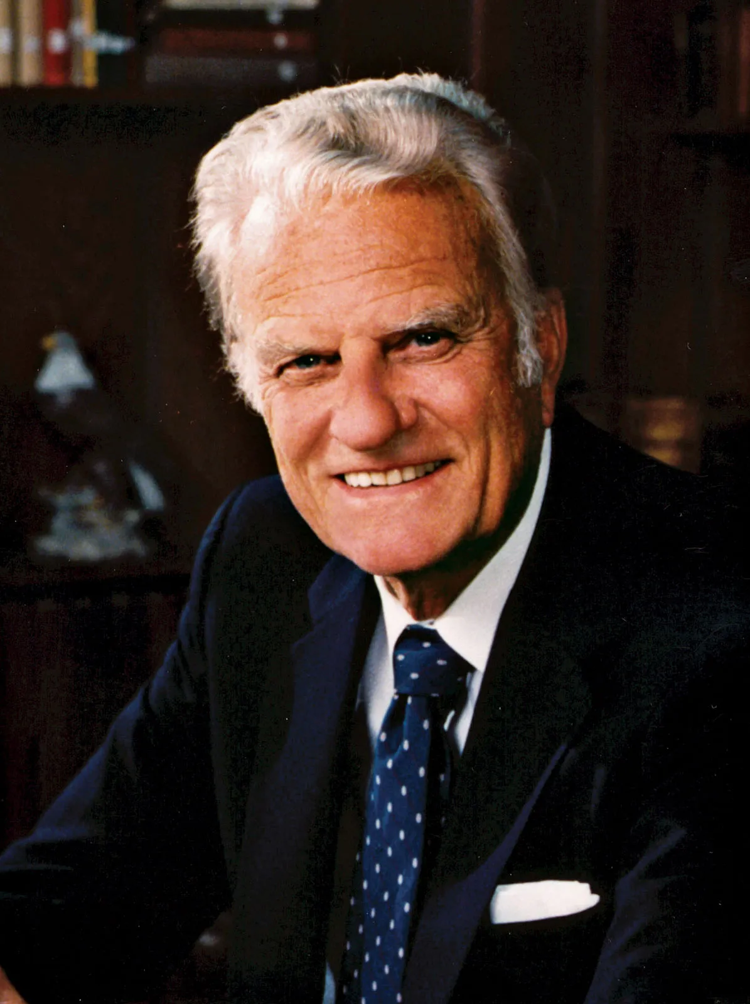
Billy Graham
“Baptism is a command of Christ (Matthew 28:19) and the Apostles (Acts 2:38), but it is not required for salvation. Baptists, like all good Protestants, believe the Bible teaches that justification is by faith alone and not by works (Romans 3:28; Ephesians 2:8-9; Titus 3:5).”

Slide 5

BAPTISM
Some Things That
Will and Will Not Do

Slide 6
Some Things Baptism Will Do For You-
Sins Are Remitted – Acts 2:38 “be baptized in the name of Jesus Christ for the remission of sins”
Saved From Sins – Mark 16:16 “believes and is baptized will be saved”
1 Peter 3:21 “ an antitype which now saves us—baptism”
Added To The Church- Acts 2:41,47 “gladly received his word were baptized” “the Lord added to the church daily those who were being saved.”
Enters Christ – Galatians 3:26,27 “baptized into Christ”

Slide 7
Some Things Baptism Will NOT Do For You-
Remove Temptation – James 1:2,3, 12-15
Ephesians 6:11 “that you may be able to stand against the wiles of the devil.”
Make One Incapable Of Sin – Romans 3:10,23
1 John 1:8-2:1 “If we say that we have no sin, we deceive ourselves” “we say that we have not sinned, we make Him a liar” “so that you may not sin. And if anyone sins”

Slide 8
Baptism Does Not Guarantee Eternal Salvation
Salvation Spoken Of In Two Senses:
Salvation from Past Sins- Mark 16:16
Eternal Salvation – 1 Peter 1:3-5 “salvation ready to be revealed in the last time.”
Warnings To The Christian About Losing His Salvation- Galatians 6:1; 5:4
Acts 8:18-23 “Repent therefore of this your wickedness, and pray God if perhaps the thought of your heart may be forgiven you.”
Luke 9:62 “ put his hand to the plow, and looking back, is fit for the kingdom of God.”

Slide 9
Baptism Is Not The End Of Obedience
Romans 6:4 “walk in newness of life”
2 Corinthians 5:17 “in Christ, he is a new creation"
Baptism Is ESSENTIAL-
You cannot be saved without it…..
BUT baptism alone will not save you any more that faith alone!
Don’t Minimize What Baptism Can Do For You!
Don’t Expect It To Do For You Things God Never Promised In His Word!

